Slide 1
USER PURCHASE BEHAVIOUR ANALYSIS
GROUP 3 PROJECT
Unlocking Revenue Trends and Strategies Through Data-Driven Insights

Slide 2
OVERVIEW OF KEY SECTIONS
DEFINING THE “WHY” OF THE PROJECT
INSIGHTS
RECOMMENDATIONS
CONCLUSION

Slide 3
DEFINING THE “WHY”
The primary purpose of this analysis is:
A. Understanding Demographics
Gender Distribution
Age Group Distribution
Why They Matter:
Helps identify target audiences for marketing and engagement strategies.
B. Identifying High-Value Markets and Products
Total Purchase Amount by Country
Top Product Categories
Average Purchase Amount by Product Category
Why They Matter:
Reveals top-performing regions and product categories to focus investments.

Slide 4
DEFINING THE “WHY”
C. Analyzing Spending Trends
Users by Purchase Amount Range
User Spend by Age Group and Gender
Why They Matter:
Shows spending habits across demographics and highlights opportunities for upselling.
D. Forecasting Future Trends
Predictive Analysis – Revenue Trends with Confidence Bounds
Why It Matters:
Helps stakeholders prepare for future scenarios and align budgets and strategies.

Slide 5
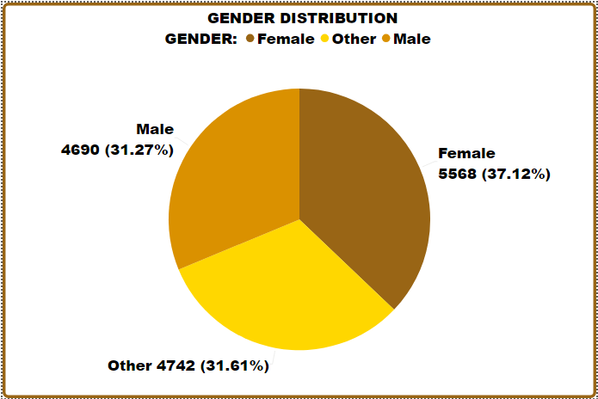
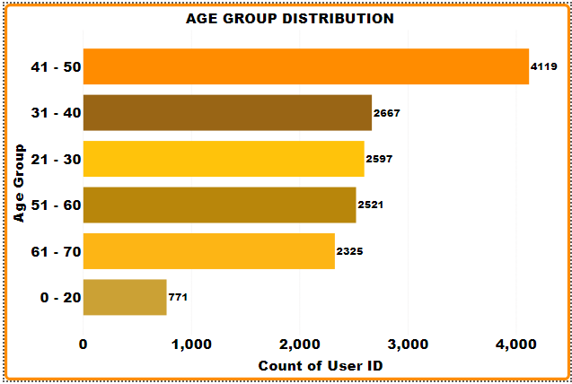
INSIGHTS : (A) DEMOGRAPHIC INSIGHTS
Gender Distribution:
Gender representation is balanced (Male: 31.27%, Female: 37.12%, Others: 31.61%), suggesting inclusive participation across categories.
2. Age Group Distribution:
The 41–50 age group dominates in both user count and spending, making it the most lucrative demographic.

Slide 6
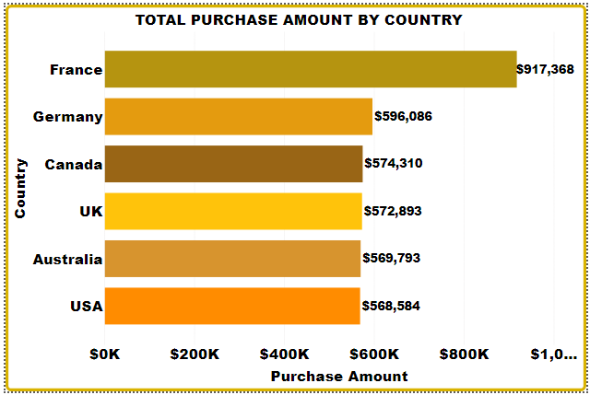
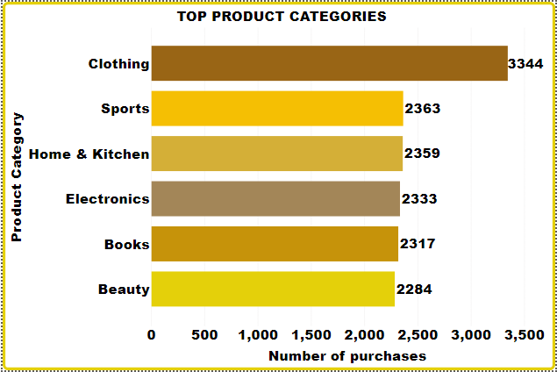
(B) MARKET AND PRODUCT INSIGHT
3. Total Purchase by Country:
France leads significantly in total purchases ($917,368.33), while the USA underperforms despite its potential.
4. Top Product Categories:
Clothing dominates purchases, while Beauty lags behind, suggesting growth opportunities in lower-performing categories.

Slide 7
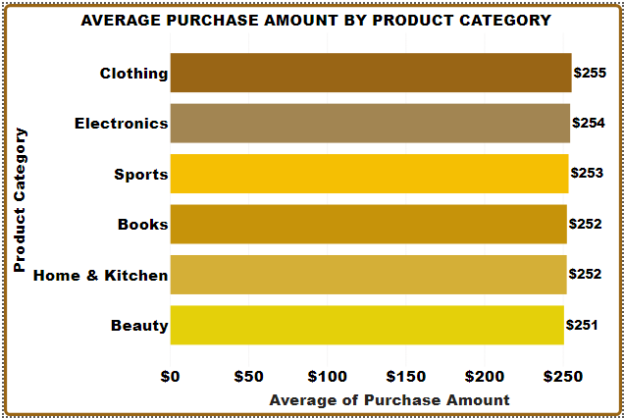
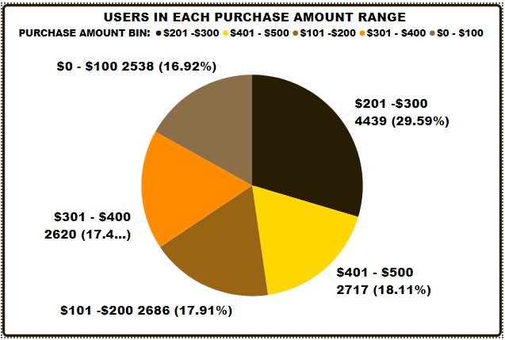
(B) MARKET AND PRODUCT INSIGHT
(C) SPENDING TRENDS
5. Average Purchase Amount by Product Category:
Clothing generates the highest average purchase value, reinforcing its importance as a focus area.
6. Users by Purchase Amount Range:
Most users fall in the $201–$300 range, indicating a mid-tier spending preference

Slide 8
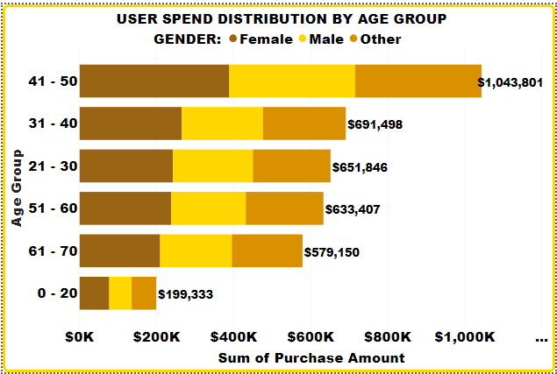
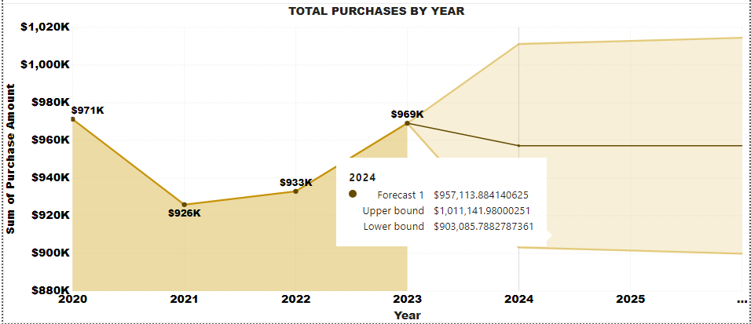
(C) SPENDING TRENDS
(D) PREDICTIVE INSIGHTS
7. User Spend by Age Group and Gender:
Females in the 41–50 age group are the highest spenders, contributing $389,169.87.
Forecast for 2024:
Total revenue is expected to stabilize around $957,113.88, with bounds reflecting possible variability.
Implication:
This steady forecast highlights opportunities to solidify growth through targeted campaigns and resource allocation.

Slide 9
RECOMMENDATIONS
Demographic Focus:
Prioritize the 41–50 age group while building engagement with younger demographics (under 20s) to ensure future growth.
Develop inclusive campaigns for all genders.
Market and Regional Strategy:
Continue investing in high-performing regions like France.
Address untapped potential in the USA with region-specific campaigns.
Product Optimization:
Expand inventory and marketing for top-performing categories like Clothing.
Revitalize interest in lower-performing categories like Beauty through promotions or new launches.
Customer Spending:
Introduce premium products to encourage higher spending among mid-tier buyers.
Offer loyalty incentives to retain high spenders.

Slide 10
RECOMMENDATIONS
5. Future Planning:
Use forecasted trends to prepare for both best-case (upper bound) and worst-case (lower bound) scenarios.
CONCLUSION
Our analysis reveals clear trends in demographics, regional performance, and product preferences.
France and the 41–50 age group are key revenue drivers, while mid-range spenders dominate purchasing behavior.
The forecasted revenue stabilization offers opportunities to solidify growth while exploring untapped markets and demographics.
WHAT IS NEXT?
Let’s use these insights to craft targeted strategies, optimize investments, and drive sustainable growth. Together, we can turn these findings into actionable business success.

Slide 11
THANK YOU

